Slide 1

DEPARTMENT OF ARTIFICIAL INTELLIGENCE AND DATA SCIENCE ACADEMIC YEAR 2025 - 2026 SEMESTER III ARTIFICIAL INTELLIGENCE LABORATORY MINI PROJECT REVIEW AI-BASED MAP COLOURING GAME USING FLOOD FILL ALGORITHM
REGISTER NUMBER | 2117240070125
NAME | Jaya Sonica S
YEAR | 2
SECTION | B
FACULTY IN-CHARGE | Mrs. M. Rubina begam

Slide 2
PROBLEM STATEMENT
Artificial Intelligence (AI) enables systems to make intelligent decisions similar to humans.
This project focuses on an interactive map coloring game using the Flood Fill algorithm to ensure that no two adjacent regions share the same color.
The system aims to automatically detect and prevent invalid coloring while offering an engaging, user-friendly experience.
The expected outcome is a visually accurate, AI-driven coloring system that demonstrates constraint satisfaction concepts and can be used for educational or visualization purposes.

Slide 3
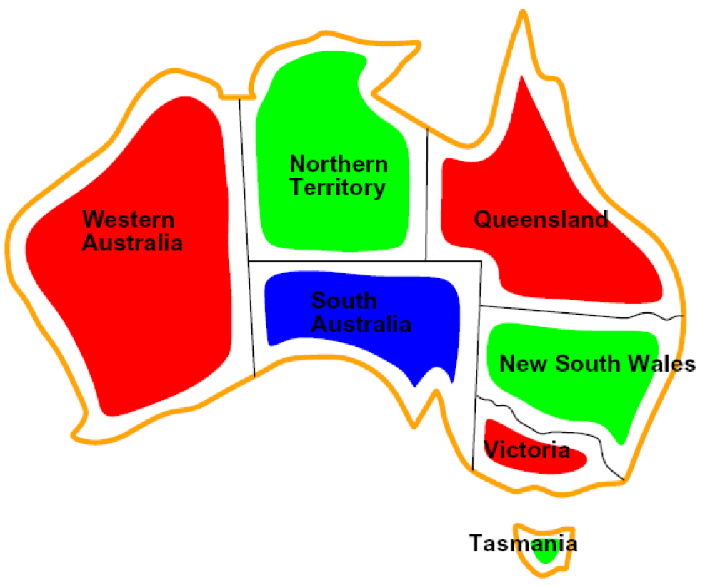
THEORETICAL BACKGROUND
The map coloring problem is a type of constraint satisfaction problem in Artificial Intelligence where no two adjacent regions should share the same color.
The project uses the Flood Fill algorithm, which identifies and fills connected regions with a selected color.
Other possible methods include Depth-First Search (DFS), Breadth-First Search (BFS), and Graph Coloring algorithms, but Flood Fill is simpler and more suitable for pixel-based images.
In this project, when a user clicks on a region, the Flood Fill algorithm spreads the chosen color to all connected pixels of the same type while checking neighboring regions to avoid duplicate colors.
This approach ensures accurate coloring, visual appeal, and real-time feedback for users.
EXAMPLE:
This map shows Australia’s states colored using the Map Coloring algorithm, ensuring that no two neighboring states share the same color.

Slide 4
IMPLEMENTATION AND CODE
Link to code in Git-hub Repository
List | Git-hub Repository Links
Implementation of Code Link | ai-mini-project/Mapcolouring.py at main · jayasonicas/ai-mini-project
Word Document Report Link | ai-mini-project/AI MINI PROJECT.docx at main · jayasonicas/ai-mini-project
PPT Link

Slide 5
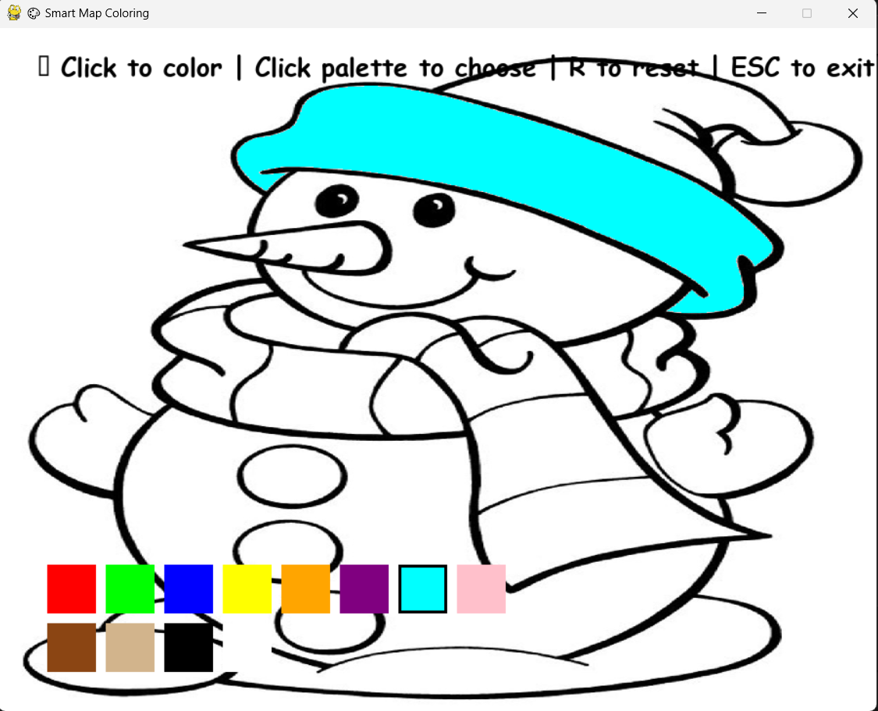
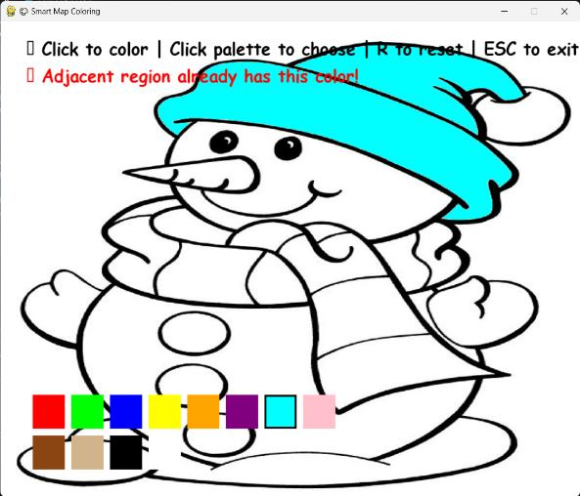
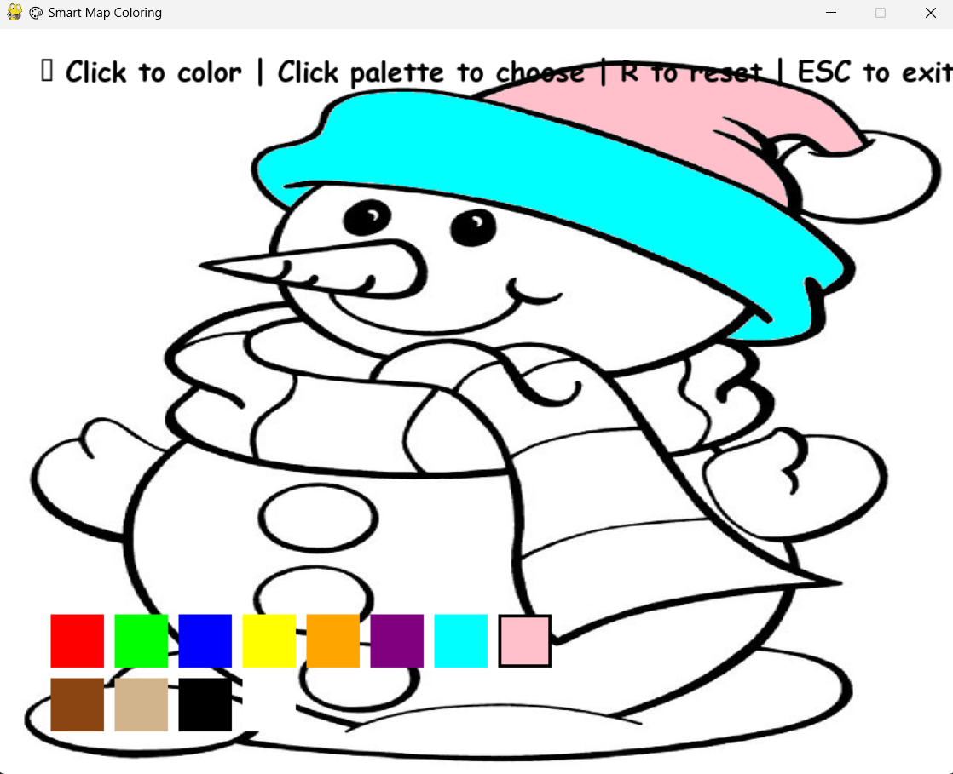
OUTPUT AND RESULTS
Output Screen shots and explanation
Figure 1: The user colors the snowman’s hat with a cyan shade
Figure 2: The system prevents applying the same color to an adjacent region and displays a warning.
Figure 3: The user selects a new color (pink) and successfully colors the next region without conflict.

Slide 6
OUTPUT AND RESULTS
RESULTS:
The system successfully colors the map so that no two adjacent regions share the same color.It provides a smooth, user-friendly interface where users can interactively color maps with real-time AI validation. The project effectively demonstrates AI-based constraint satisfaction using the Flood Fill algorithm.
FUTURE ENHANCEMENTS:
Include game levels or scoring systems for educational or entertainment use.
Introduce AI-based color suggestions for better visualization.
Enable mobile and web versions for wider accessibility.

Slide 7
REFERENCES
Russell, S. J., & Norvig, P. (2021). Artificial Intelligence: A Modern Approach (4th Edition). Pearson Education.
2.GeeksforGeeks. Flood Fill Algorithm – Explanation and Implementation
3.TutorialsPoint. Artificial Intelligence – Constraint Satisfaction Problems.
4.Python. Working with Graphics and Pygame in Python. https://realpython.com/pygame-a-primer
5.Medium Blog. Understanding Map Coloring and Graph Coloring Problems. https://medium.com/

